Slide 1

Relational Model

Slide 2
Agenda
Logical Modeling using Relational Diagrams/Schema Diagrams
Relational Keys (Super key, candidate key, Primary key, foreign key, composite key, alternate key)
Constraints(Entity, Domain, Referential Integrity)
Mapping ER Diagrams to Relational Diagrams

Slide 3
Relational Structure
We can express the structure of a relation by a Tuple, a shorthand notation.
The name of the relation is followed (in parentheses) by the names of the attributes of that relation, e.g.:
EMPLOYEE1(Emp_ID,Name,Dept,Salary).
Notes:
Codd’s Rules
1. Information Rule: All data is represented in the form of
relations / tables (with rows & columns)
2. Guaranteed Access Rule: The DBMS can refer to every single value in the database (by using a combination of the table name & the primary key)
3. Systematic Treatment of Null Values: The concept of missing / non-available values should be distinct from blank fields / fields with 0’s in it
4. Active On-Line Catalog: based on the relational model – i.e. the database schema / definitions can be represented in the form of tables (and retrieved as such)
5. Comprehensive Data Sub-Language Rule: The system must support at least one relational language (based on either
Relational Algebra / Relational Calculus) and should allow the definition & manipulation of database objects using this
6. View Updating Rule: Any views that are theoretically updateable, should be allowed to be so
7. High Level Update: The user should be allowed to Delete / Update a set of tuples (rather than row by row)
Physical Data Independence: Application programs and terminal activities remain logically unimpaired whenever any changes are made in either storage representation or access methods.
6. View Updating Rule: Any views that are theoretically updateable, should be allowed to be so
7. High Level Update: The user should be allowed to Delete / Update a set of tuples (rather than row by row)
8. Physical Data Independence: Application programs and terminal activities remain logically unimpaired whenever any changes are made in either storage representation or access methods.
9. Logical Data Independence: Application programs and terminal activities remain logically unimpaired when information preserving changes of any kind that theoretically permit unimpairment are made to the base tables.
10. Integrity Independence: The DBMS should allow the definition of constraints (rules / triggers / etc.) independent of application programs
11. Distribution Independence: If the database were to be taken and split into parts residing in different places, this should be invisible to the users
12. Non-Subversion Rule: Even if the system allowed access to the data through a low level language (e.g. access a tuple at a time through 'C') it should go through the DBMS and hence ensure that the constraints are not violated

Slide 4

Relational keys
Must be able to store and retrieve a row of data in a relation, based on the data values stored in that row.
A primary key is an attribute (or combination of attributes) that uniquely identifies each row in a relation.
The primary key in the EMPLOYEE1 relation is EMP_ID (this is why it is underlined) as in:
EMPLOYEE1(Emp_ID,Name,Dept,Salary).

Slide 5
Composite and Foreign keys
A Composite key is a primary key that consists of more than one attribute.
e.g., the primary key for the relation DEPENDENT would probably consist of the combination Emp-ID and Dependent_Name.
A Foreign key is used when we must represent the relationship between two tables and relations
A foreign key is an attribute (possibly composite) in a relation of a database that serves as the primary key of another relation in the same database

Slide 6
Foreign keys
Consider the following relations:
EMPLOYEE1(Emp_ID,Name,Dept_Name,Salary)
DEPARTMENT(Dept_Name,Location,Fax)
The attribute Dept_Name is a foreign key in EMPLOYEE1. It allows the user to associate any employee wit the department they are assigned to.
Some authors show the fact that an attribute is a foreign key by using a dashed underline.

Slide 7
Relational Keys
Super Key : An attribute (or combination of attributes) that uniquely identifies each entity in a table.
Candidate Key : A minimal super key. A super key that does not contain a subset of attributes that is itself a super key.
Primary key : A candidate key selected to uniquely identify all other attribute values in any given row. Cannot contain null entries.
Secondary Key : An attribute ( or combination of attributes) used strictly for data retrieval.

Slide 8
Removing Multivalued attributes from tables
In the table, an entry at the intersection of each row and column is atomic (single-valued) - there can be no multivalued attributes in a relation, an example of this would be if each employee had taken more than one course, e.g.:
EMP_ID | Ename | Company | Course
A1 | Fred Bloggs | Satyam | Delphi VB

Slide 9
Removing Multivalued attributes from tables
To avoid this, we should create a new relation (EMPLOYEE2) which has a new instance for each course the employee has taken, e.g.:
EMP_ID | Ename | Company | Course
A1 | Fred Bloggs | Satyam | Delphi
A1 | Fred Bloggs | Satyam | VB

Slide 10
Example Database
The structure of the database is described by the use of a conceptual schema, which is a description of the overall logical structure of a database.
There are two common methods for expressing a conceptual schema:
Short text statements, in which each relation is named and the names of its attributes follow in parentheses
A graphical representation, in which each relation is represented by a rectangle containing the attributes for the relation.

Slide 11
Expressing the Conceptual Schema
Text statements have the advantage of simplicity, whilst the graphical representation provides a better means of expressing referential integrity constraints (discussed later).
Here is a text description for four relations:
CUSTOMER(Customer_ID, Customer_Name, Address, City, State, Zip)
ORDER(Order_ID, Order_Date, Customer_ID)
ORDER_LINE(Order_ID, Product_ID, Quantity)
PRODUCT(Product_ID, Product_Description, Product_Finish, Standard_Price, On_Hand)

Slide 12
Expressing the Conceptual schema
Note that the primary key for ORDER_LINE is a composite key consisting of the attributes Order_ID and Product_ID
Also, Customer_ID is a foreign key in the ORDER relation, allowing the user to associate an order with a customer
ORDER_LINE has two foreign keys, Order_ID and Product_ID, allowing the user to associate each line on an order with the relevant order and product
A graphical representation of this schema is shown in the following Fig.

Slide 13
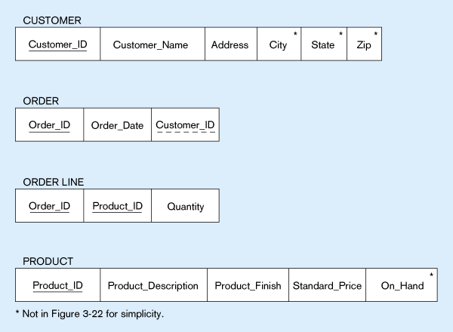
Schema for four relations (Pine Valley Furniture)
Primary Key
Foreign Key (implements 1:N relationship between customer and order)
Combined, these are a composite primary key (uniquely identifies the order line)…individually they are foreign keys (implement M:N relationship between order and product)

Slide 14

Integrity Constraints
These help maintain the accuracy and integrity of the data in the database
Domain Constraints - a domain is the set of allowable values for an attribute.
Domain definition usually consists of 4 components: domain name, meaning, data type, size (or length), allowable values/allowable range (if applicable)
Entity Integrity ensures that every relation has a primary key, and that all the data values for that primary key are valid. No primary key attribute may be null.

Slide 15

Entity integrity
In some cases a particular attribute cannot be assigned a data value, e.g. when there is no applicable data value or the value is not known when other values are assigned
In these situations we can assign a null value to an attribute (null signifies absence of a value)
But still primary key values cannot be null – the entity integrity rule states that “no primary key attribute (or component of a primary key attribute) may be null

Slide 16
Integrity Constraints
A Referential Integrity constraint is a rule that maintains consistency among the rows of two relations – it states that any foreign key value (on the relation of the many side) MUST match a primary key value in the relation of the one side. (Or the foreign key can be null).
In the following Fig., an arrow has been drawn from each foreign key to its associated primary key. A referential integrity constraint must be defined for each of these arrows in the schema

Slide 17
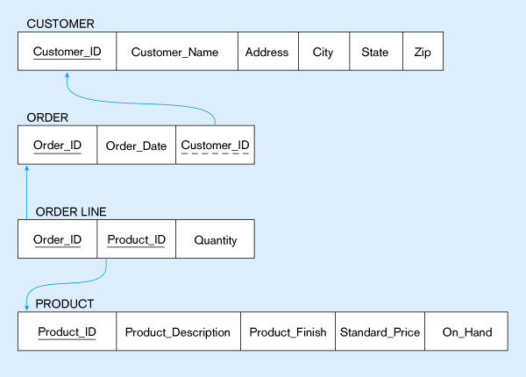
Referential integrity Constraints (Pine Valley Furniture)
Referential integrity constraints are drawn via arrows from dependent to parent table

Slide 18
Referential Integrity
How do you know if a foreign key is allowed to be null?
In this example, as each ORDER must have a CUSTOMER the foreign key of Customer_ID cannot be null on the ORDER relation
Whether a foreign key can be null must be specified as a property of the foreign key attribute when the database is designed

Slide 19
Referential Integrity
Whether foreign key can be null can be complex to model, e.g. what happens to order data if we choose to delete a customer who has submitted orders? We may want to see sales even though we do not care about the customer anymore.
3 choices are possible:
Restrict – don’t allow delete of “parent” side if related rows exist in “dependent” side, i.e. prohibit deletion of the customer until all associated orders are first deleted

Slide 20
Referential Integrity
Cascade – automatically delete “dependent” side rows that correspond with the “parent” side row to be deleted, i.e. delete the associated orders, in which case we lose not only the customer but also the sales history
Set-to-Null – set the foreign key in the dependent side to null if deleting from the parent side - an exception that says although an order must have a customer_ID value when the order is created, Customer_ID can become null later if the associated customer is deleted [not allowed for weak entities]

Slide 21
Creating Relational Tables
These example tables are created using CREATE TABLE statements from SQL
In practice, they are usually created in the implementation phase later on in the development process
However, we create them here to explain some concepts
One table is created for each table shown in the relational schema (previous Fig.)

Slide 22
Creating Relational Tables
Each attribute is defined, taking the data type and length from the domain definitions
For example, the attribute Customer_Name can be defined as a VARCHAR (variable character) type with length 25
By specifying NOT NULL, each attribute can be constrained from being assigned a null value
The primary key for each table is specified using the PRIMARY KEY clause at the end of each table definition

Slide 23
Creating Relational Tables
CREATE TABLE CUSTOMER
(CUSTOMER_ID VARCHAR(5) NOT NULL
CUSTOMER_NAME VARCHAR(25) NOT NULL
Etc.
PRIMARY KEY (CUSTOMER_ID) );

Slide 24
Creating Relational Tables
CREATE TABLE ORDER
(ORDER_ID CHAR(5) NOT NULL
ORDER_DATE DATE NOT NOT NULL
CUSTOMER_ID VARCHAR(5) NOT NULL
PRIMARY KEY (ORDER_ID)
FOREIGN KEY (CUSTOMER_ID) REFERENCES USTOMER(CUSTOMER_ID);

Slide 25
Creating Relational Tables
Referential integrity constraints are easily defined using the graphical schema
An arrow originates from each foreign key and points to the related primary key in the associated relation
In SQL, a FOREIGN KEY REFERENCES statement corresponds to one of these arrows
The foreign key CUSTOMER_ID references the primary key of CUSTOMER, which is also CUSTOMER_ID
Although here the foreign and primary keys have the same name, this need not be the case – but the foreign and primary keys must be from the same domain

Slide 26
Creating Relational Tables
The ORDER_LINE table illustrates how to specify a primary key when that key is a composite attribute of two foreign keys:
CREATE TABLE ORDER_LINE
(ORDER_ID CHAR(5) NOT NULL
PRODUCT_ID CHAR(5) NOT NULL
QUANTITY INT NOT NULL
PRIMARY KEY(ORDER_ID, PRODUCT_ID)
FOREIGN KEY (ORDER_ID) REFERENCES ORDER(ORDER_ID)
FOREIGN KEY (PRODUCT_ID) REFERENCES PRODUCT(PRODUCT_ID);

Slide 27
A One-to-One Relationship Example
LOCKER
EMPLOYEE
1:1

Slide 28
One Representation of a One-to-One Relationship
Locker
Employee
LockerID
Primary Key
EmpID
LockerDesc
LockerID
Foreign Key
Location
EmpName

Slide 29
Another Representation of a One-to-One Relationship
Locker
Employee
LockerID
Primary Key
EmpID
EmpID
EmpName
Foreign Key
LockerDesc
Location

Slide 30
Mandatory One-to-One Relationships
A mandatory 1:1 relationship can easily be collapsed back into one relation. While there are times when the added complexity is warranted…
Added security
Infrequently accessed data components
…very often these relations are collapsed into one

Slide 31
One-to-Many Relationships
Like a 1:1 relationship, a 1:N relationship is saved by placing the key from one table into another as a foreign key. Where does the foreign key go?
In a 1:N the foreign key always goes into the many-side

Slide 32
A One-to-Many Relationship Example
DEPARTMENT
EMPLOYEE
1:N

Slide 33
Representing a One-to-Many Relationship
Department
Employee
DeptID
Primary Key
EmpID
DeptName
DeptID
Foreign Key
Location
EmpName

Slide 34
Representing Many-to-Many Relationships
To save a M:N relationship, a new relation is created. This relation is called an intersection relation. What is the primary key of this new relation?
An intersection relation has a composite key consisting of the keys from each of the tables that formed it

Slide 35
A Many-to-Many Relationship Example
SKILL
EMPLOYEE
N:M

Slide 36
Representing a Many-to-Many Relationship
Employee
Skill
EmpID
SkillID
EmpName
SkillDesc
Emp_Skill
SkillID
Foreign Key
EmpID
Foreign Key

Slide 37
Representing Recursive Relationships
A recursive relationship is a relationship that a relation has with itself.
Recursive relationships adhere to the same rules as the binary relationships.
1:1 and 1:M relationships are saved using foreign keys
M:N relationships are saved by creating an intersecting relation

Slide 38
A Recursive Relationship Example
EMPLOYEE
1:N
Manages

Slide 39
Representing a Recursive Relationship
Employee
EmpID
EmpID (FK)
Foreign Key is
The EmpID of the
Manager
EmpName

Slide 40
Transforming ER diagrams into Relations
This can be done automatically by many CASE tools, but it is important to understand because:
Case tools often cannot model complex data relationships such as ternary relationships and supertype/subtype relationships. For these situations you may have to perform these steps manually
Sometimes alternative solutions exist, and you must choose the best
You must be able to quality check the CASE tool results

Slide 41
Remember Entity types!
Regular entities – have an independent existence and generally represent real-world objects = [rectangles with a single line]
Weak entities cannot exist on there own, they exist with an identifying relationship with an owner regular entity type = [[rectangles with a double line]]
Associative entities (gerunds) are formed from many-to-many relationships between other entity types = [<rectangle enclosing the diamond relationship symbol>]

Slide 42
Step 1: Map Regular Entities
Each regular entity type in an ER diagram is transformed into a relation
The name given to the relation is generally the same as the entity type
Each simple attribute of the type becomes an attribute of the relation
The identifier of the entity type becomes the primary key of the corresponding relation
The following 2 Figs. show an example of this

Slide 43
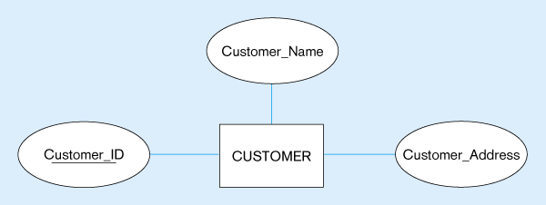
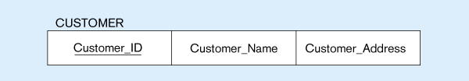
Mapping a Regular Entity
(a) CUSTOMER entity type with simple attributes
(b) CUSTOMER relation

Slide 44
Composite Attributes
When a regular entity type has composite attributes, only the simple component attributes of the composite attribute are included in the new relation
The following Fig. Shows a variation on the previous one, where Customer_Address is represented as a composite attribute with components Street, City, State and Zip

Slide 45
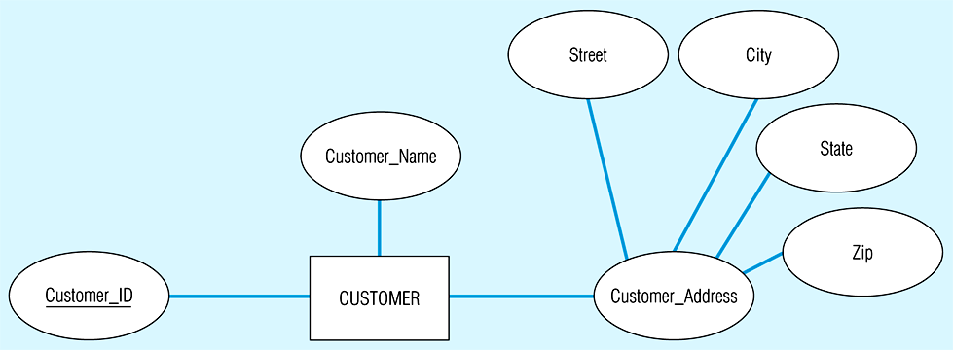
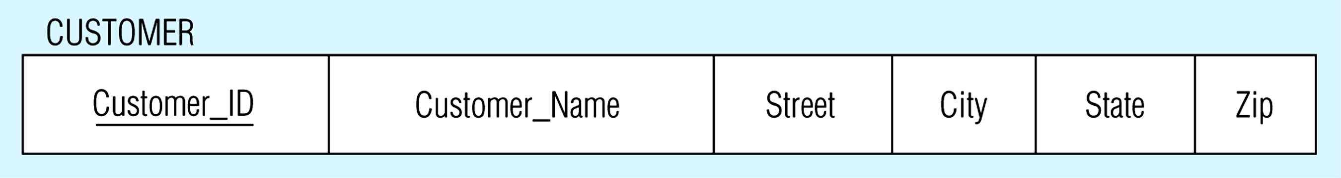
Mapping a composite attribute
(a) CUSTOMER entity type with composite attribute
(b) CUSTOMER relation with address detail

Slide 46
Multi-valued Attributes
Here two new relations (rather than one) are created
First relation contains all of the attributes of the entity type except the multivalued attribute
Second relation contains two attributes that form the primary key of the second relation
The first of these is the primary key for the first relation, which becomes a foreign key in the second relation
The second is the multivalued attribute

Slide 47
Multi-valued Attributes
In the following Fig. EMPLOYEE has ‘Skill’ as a multi-valued attribute
The first relation EMPLOYEE has the primary key Employee_ID
The second relation EMPLOYEE_SKILL has the two attributes Employee_ID and Skill, which form the primary key
The relationship between foreign and primary keys is indicated by the arrow in the figure

Slide 48
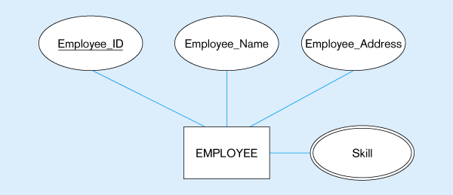
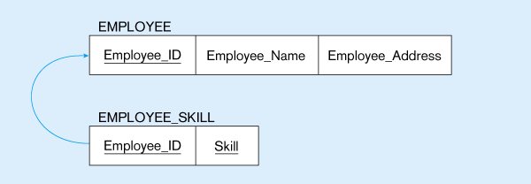
Mapping a multivalued attribute
(a)
Multivalued attribute becomes a separate relation with foreign key
(b)
1 – to – many relationship between original entity and new relation

Slide 49
Step 2: Map Weak Entities
You must already have created a relation corresponding to the identifying type
For each weak entity type, create a new relation and include all of the simple attributes (or simple components of composite attributes) as attributes of this relation
Then include the primary key of the identifying relation as a foreign key attribute in this new relation
The primary key of the new relation is the combination of this primary key of the identifying and the partial identifier of the weak entity type

Slide 50
Map weak entities
The following figure shows the weak identity type DEPENDENT and its identifying entity type EMPLOYEE, linked by the identifying relationship ‘Has’
The attribute Dependent_Name (the partial identifier for this relation) is a composite attribute with components First_Name, Middle_Initial and Last_Name
– so we assume that for a given employee these items will uniquely identify a dependent. The primary key of DEPENDENT consists of four attributes: Employee_ID, First_Name, Middle_Initial and Last_Name. The foreign key relationship with its primary key is indicated by the arrow in the Fig.

Slide 51
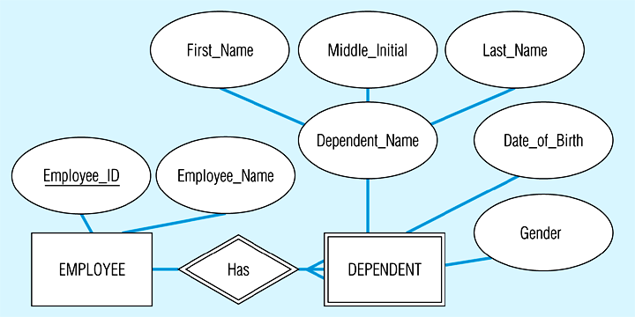
Example of mapping a weak entity
(a) Weak entity DEPENDENT

Slide 52
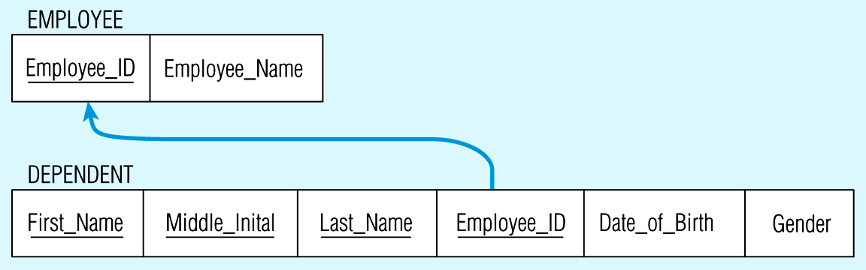
Relations resulting from weak entity
NOTE: the domain constraint for the foreign key should NOT allow null value if DEPENDENT is a weak entity
Foreign key
Composite primary key

Slide 53
Step 3: Map Binary Relationships
The procedure for representing relationships depends on both the degree of the relationships (unary, binary, ternary) and the cardinalities of the relationships.

Slide 54
Map binary one-to-many (1:M)
First create a relation for each of the two entity types participating in the relationship
Next include the primary key attribute(s) of the entity on the one-side as a foreign key in the relation that is on the many-side
‘Submits’ relationship in the following Fig. shows the primary key Customer_ID of CUSTOMER (the one-side) included as a foreign key in ORDER (the many-side) (signified by the arrow)

Slide 55
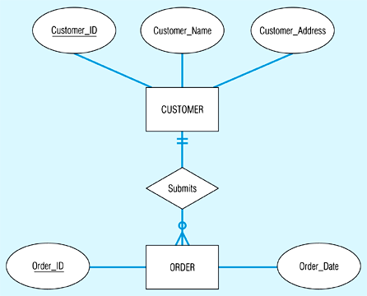
Example of mapping a 1:M relationship
Relationship between customers and orders
Note the mandatory one

Slide 56
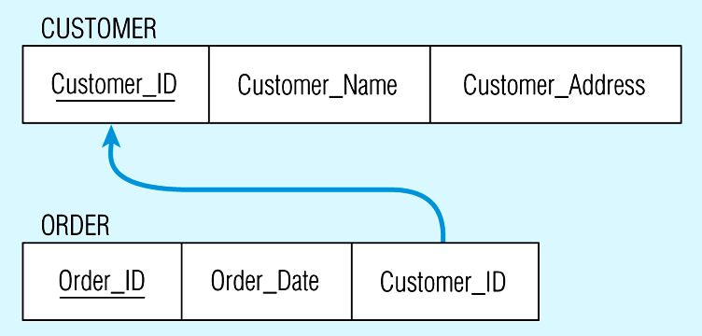
Mapping the relationship
Again, no null value in the foreign key…this is because of the mandatory minimum cardinality
Foreign key

Slide 57
Map binary many-to-many (M:N) relationships
If such a relationship exists between entity types A and B, we create a new relation C, then include as foreign keys in C the primary keys for A and B, then these attributes become the primary key of C
In the following Fig., first a relation is created for VENDOR and RAW_MATERIALS, then a relation QUOTE is created for the ‘Supplies’ relationship – with primary key formed from a combination of Vendor_ID and Material_ID (primary keys of VENDOR and RAW_MATERIALS). These are foreign keys that point to the respective primary keys

Slide 58
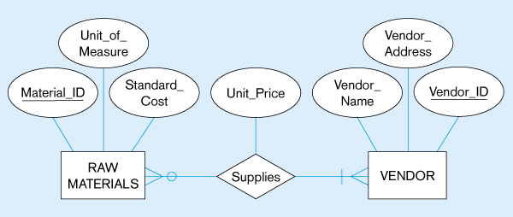
Example of mapping an M:N relationship
The Supplies relationship will need to become a separate relation

Slide 59
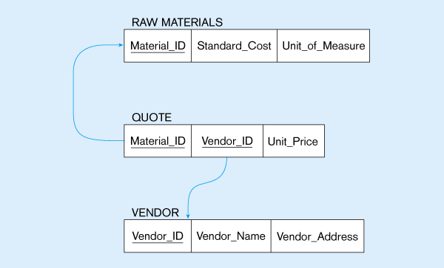
Three resulting relations
Composite primary key
New intersection relation
Foreign key
Foreign key

Slide 60
Map binary one-to-one relationships
These can be viewed as a special case of one-to-many relationships. Firstly, two relations are created, one for each of the participating entity types
Secondly, the primary key of one of the relations is included as a foreign key in the other relation
In a 1:1 relationship, the association in one direction is nearly always optional one, whilst the association in the other direction is mandatory one
You should include in the relation on the optional side of the relationship the foreign key of the entity type that has the mandatory participation in the 1:1 relationship

Slide 61
Map binary one-to-one relationships
This approach avoids the need to store null values in the foreign key attribute
Any attributes associated wit the relationship itself are also included in the same relation as the foreign key
The following Fig. Shows a binary 1:1 relationship between NURSE and CARE_CENTER, where each care centre must have a nurse who is in charge of that centre – so the association from care centre to nurse is a mandatory one, while the association from nurse to care centre is an optional one (since any nurse may or may not be in charge of a care centre)

Slide 62
Map binary one-to-one relationships
The attribute Date_Assigned is attached to the In_Charge relationship
Since CARE_CENTER is the optional participant, the foreign key (Nurse_In_Charge) is placed in this relation – it has the same domain as Nurse_ID and the relationship with the primary key is shown.
The attribute Date Assigned is also located in CARE_CENTER and would not be allowed to be null

Slide 63
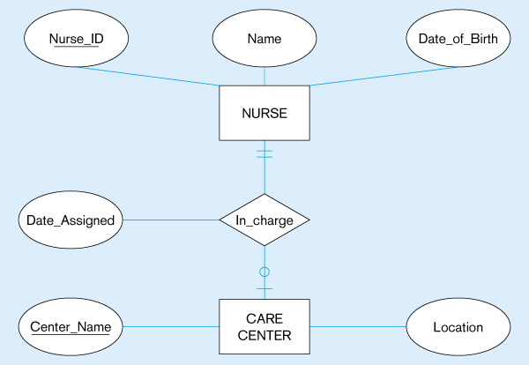
Mapping a binary 1:1 relationship
Binary 1:1 relationship

Slide 64
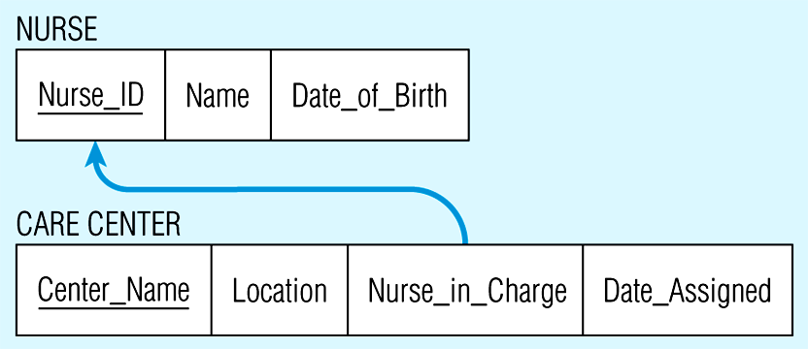
Resulting relations

Slide 65
Step 4: Map Associative Entities
When a user can best visualise a relationship as an associative entity (rather than an M:N relationship) we follow similar steps to mapping an M:N relationship
Three relations are created, one for each of the two participating entity types and the third for the associative entity
The relation formed is called the associative relation
The next step depends on whether on the ER diagram an identifier was assigned to the associative entity

Slide 66
Identifier not assigned
Here the default primary key for the associative relation consists of the two primary key attributes from the other two relations
These attributes are then foreign keys that reference the other two relations

Slide 67
Thank you
Visit us at www.techmahindra.com
Disclaimer
Tech Mahindra Limited, herein referred to as TechM provide a wide array of presentations and reports, with the contributions of various professionals. These presentations and reports are for informational purposes and private circulation only and do not constitute an offer to buy or sell any securities mentioned therein. They do not purport to be a complete description of the markets conditions or developments referred to in the material. While utmost care has been taken in preparing the above, we claim no responsibility for their accuracy. We shall not be liable for any direct or indirect losses arising from the use thereof and the viewers are requested to use the information contained herein at their own risk. These presentations and reports should not be reproduced, re-circulated, published in any media, website or otherwise, in any form or manner, in part or as a whole, without the express consent in writing of TechM or its subsidiaries. Any unauthorized use, disclosure or public dissemination of information contained herein is prohibited. Unless specifically noted, TechM is not responsible for the content of these presentations and/or the opinions of the presenters. Individual situations and local practices and standards may vary, so viewers and others utilizing information contained within a presentation are free to adopt differing standards and approaches as they see fit. You may not repackage or sell the presentation. Products and names mentioned in materials or presentations are the property of their respective owners and the mention of them does not constitute an endorsement by TechM. Information contained in a presentation hosted or promoted by TechM is provided “as is” without warranty of any kind, either expressed or implied, including any warranty of merchantability or fitness for a particular purpose. TechM assumes no liability or responsibility for the contents of a presentation or the opinions expressed by the presenters. All expressions of opinion are subject to change without notice.

